Slide 1
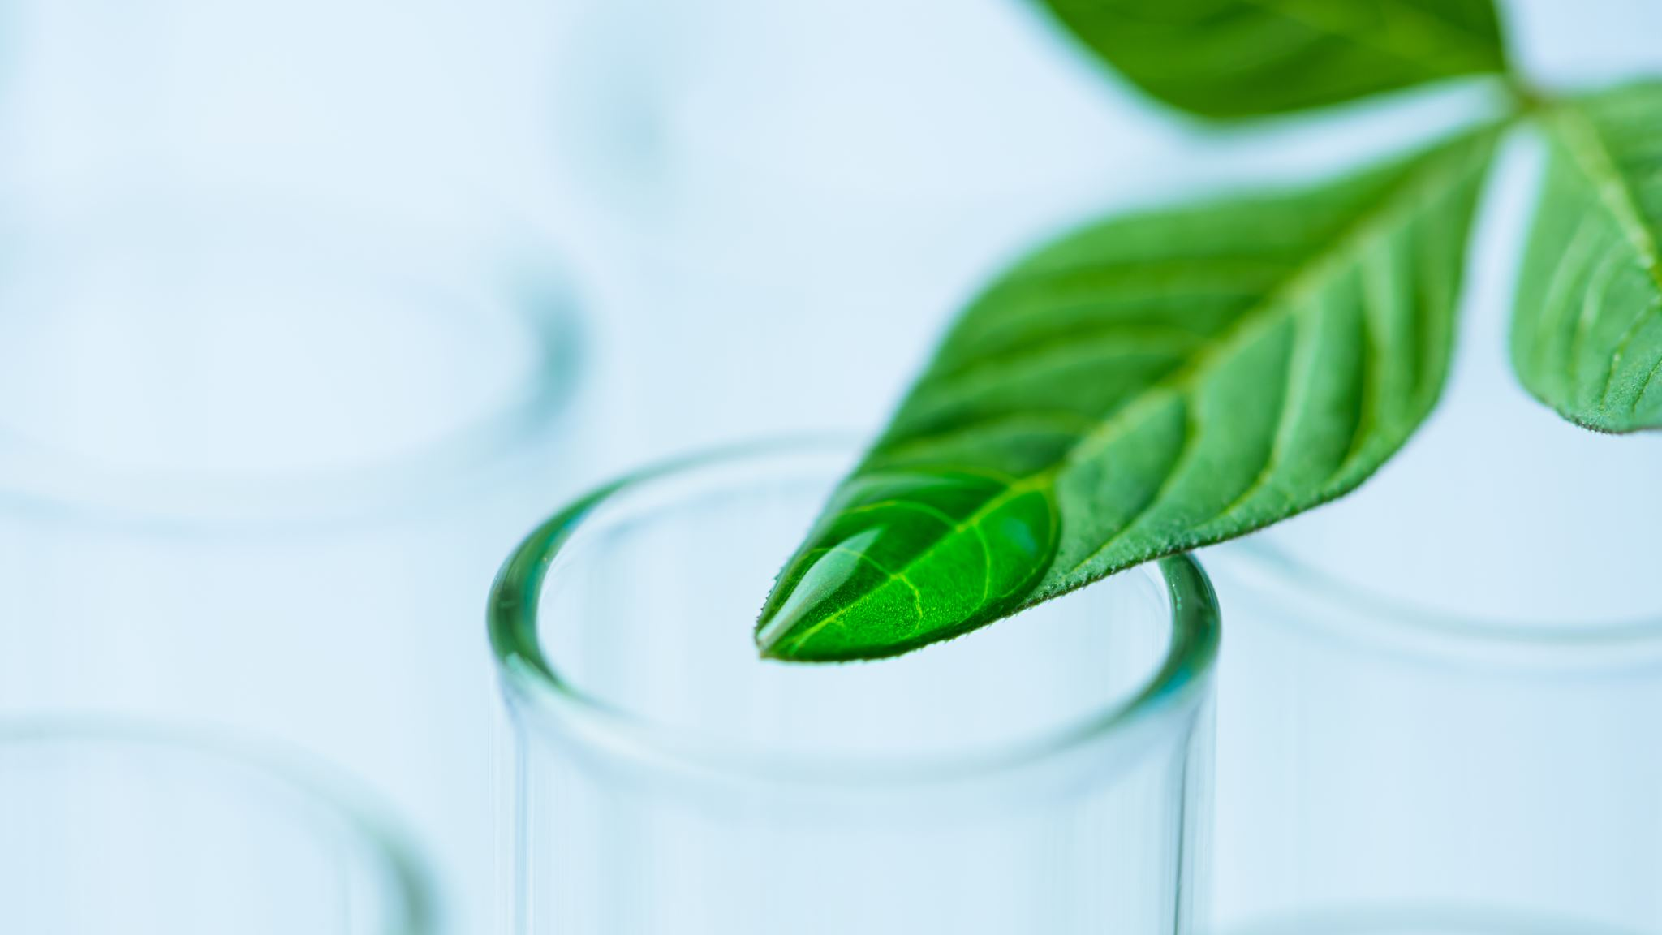
Climate-conscious Biomedical Science: Sustainable Strategies for the Future
Daniel Mucida (Rockefeller)
&
Carolina Lucas (Yale)
Notes:
Introduction (2 minutes)
• Brief Overview: Research and its general environmental impacts.
Research activities, while advancing scientific knowledge, often come with significant environmental impacts. Laboratories are energy-intensive spaces, consuming large amounts of electricity to power equipment such as freezers, centrifuges, and fume hoods. Additionally, research generates substantial waste, including hazardous chemicals, biological materials, and plastic disposables. Understanding these impacts is crucial for developing strategies to mitigate them, ensuring that scientific progress does not come at the expense of the environment.
• Purpose of the Discussion: Explain the importance of understanding and mitigating environmental impacts.
The goal of today’s presentation is to highlight the environmental impacts of research and to discuss practical steps that can be taken to reduce these impacts. By fostering awareness and encouraging sustainable practices within the research community, we can collectively contribute to a more sustainable future. This discussion is not only about identifying problems but also about informing about solutions.

Slide 2
The Environmental impact of Research
Areas we would cover if we had the entire week
Carbon footprint of research: mitigation strategies at the individual, laboratory, institution (and above) levels
Adapting our research to a changing climate: Incorporating climate change into our set of questions
Waking up to a defining moment: researching topics that directly affect climate change
Notes:
According to the latest Intergovernmental Panel on Climate Change (IPCC) report, “There is a rapidly closing window of opportunity to secure a livable and sustainable future for all.” As scientists who seek to understand the innerworkings of the human body, we recognize that planetary health and human well-being are inextricably linked. Science can help tackle climate change-related problems, with measures such as treatment and prevention strategies to combat diseases associated with environmental change, cleaner energy sources, and improved agricultural processes; however, scientific progress is unpredictable, and relying on nonexistent technologies is unwise. In the meantime, we need to address the research enterprise’s sizable environmental impact. Researchers, institutions, funders, and policymakers must collaborate to reduce this impact and secure a hopeful future.
Links:
https://www.nature.com/articles/s41590-023-01546-6
https://report.ipcc.ch/ar6syr/pdf/IPCC_AR6_SYR_SPM.pdf
https://www.nature.com/articles/d41586-024-03011-2

Slide 3
We will (quickly) go over these topics today
Energy Consumption
Waste generation
Utilization of resources
Carbon Footprint
Sustainable Research Practices
Policy and Funding
Innovations in Sustainability
Notes:
Research laboratories contribute to the energy and water use, emissions, and waste generation. Some of this can be mitigated through shifts in practices and culture. At the institutional level, changes to airflow and heating systems and climate-smart buildings have helped Rockefeller University to achieve a 31% reduction in carbon emissions. Setting ultralow temperature freezers at -70 rather than -80 C can translate to energy savings of 35%, and closing fume hoods and turning off unused lights and equipment also dramatically reduces energy expenditure. Climate-sensitive purchasing and laboratory practices can also have a major impact. Having received early scientific training in Brazil, TC and DM recall practices borne of economic need that are now applied for the sake of environmental necessity, from washing Eppendorf tubes and pipette tips to carefully optimizing the use of laboratory animals. Sustainable lab practices, such as washing and reusing plastic materials and tubes and replacing single-use plastic with glass, should be broadly adopted (see examples compiled by Winter et al.).
To encourage sustainable practices, educational programs should be integrated into the scientific training. At Rockefeller, institution-wide sustainability training increased participation in plastic recycling and improved lab purchasing patterns. Raising awareness has also led to the transfer of sustainability practices from the laboratory to the home, for example, through increased utilization of non-disposable food ware, participation in composting, and setting indoor temperatures higher in the summer and colder in the winter.
Links:
https://www.rockefeller.edu/news/6804-rockefeller-announces-31-percent-reduction-in-carbon-emissions/
https://www.maxperutzlabs.ac.at/about/sustainability/initiatives-and-projects
https://www.rockefeller.edu/news/26596-tips-for-a-greener-lab/
https://www.embopress.org/doi/full/10.15252/embr.202256683

Slide 4
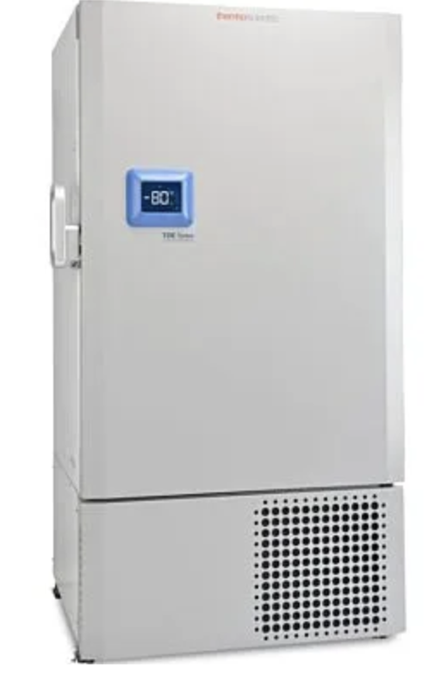
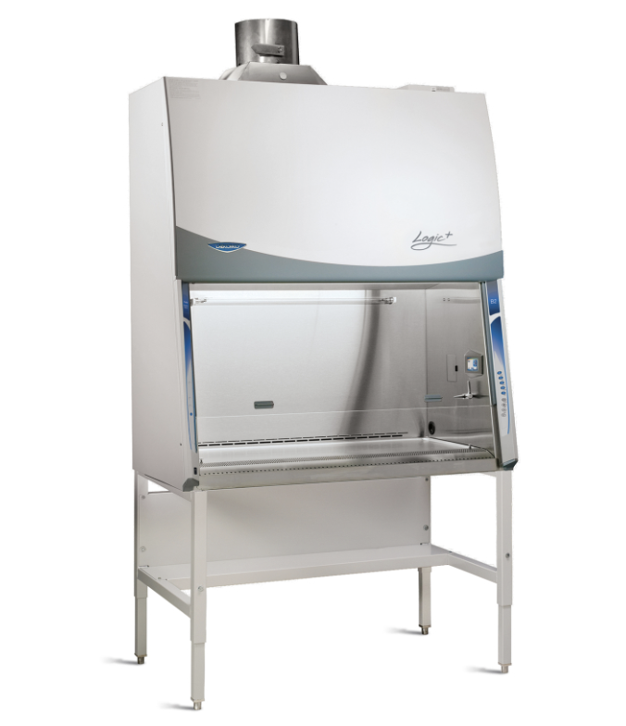
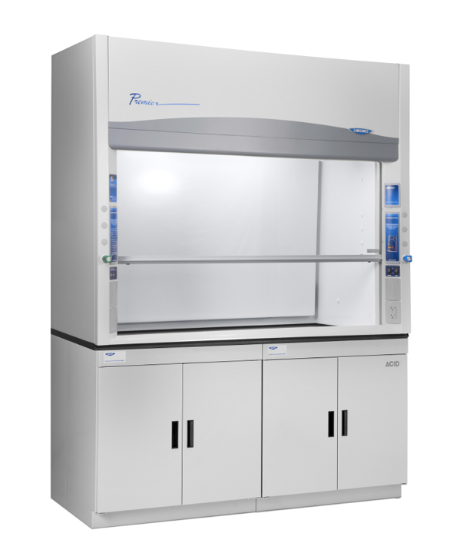
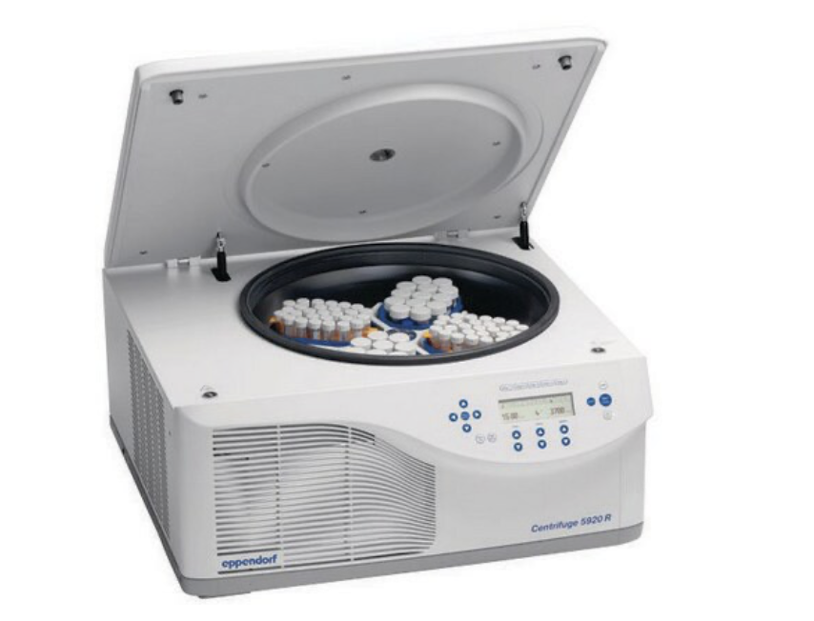
Lab Energy consumption
Laboratories are among the most energy-intensive spaces in academic institution
Most Energy-Intensive Equipment in Laboratories:
Ultra-Low Temperature (ULT) Freezers, 20 kWh per day, equivalent to the energy consumption of a small house.
Climate-Controlled Rooms (e.g., cold rooms, warm rooms), two average households combined.
Autoclaves, 10 kWh per cycle, clothes dryer for five hours.
Fume Hoods, 3.5 kWh per hour when fully open.
Centrifuges, 2.0 kWh per use (varies with size and duration of use)- dishwasher cycle.
Biological Safety Cabinets, 2.0 kWh per hour, space heater running on high for an hour.
Incubators, Around 1.5 kWh per day. microwave oven used for one hour .
Notes:
Energy Consumption (4 minutes)
• Laboratory Energy Use: Highlight energy-intensive equipment and processes (e.g., freezers, fume hoods, centrifuges).
Laboratories are among the most energy-intensive spaces in academic institutions, with equipment like ultra-low temperature (ULT) freezers, fume hoods, and centrifuges consuming significant amounts of electricity. ULT freezers, for instance, can use as much energy as a small house, and fume hoods left open can waste a considerable amount of conditioned air. This high energy consumption contributes to greenhouse gas emissions and increases operational costs.
Most Energy-Intensive Equipment in Laboratories
1. Ultra-Low Temperature (ULT) Freezers
Energy Use: Approximately 20 kWh per day, equivalent to the energy consumption of a small house.
Comparison: A single ULT freezer can use as much energy in a day as an average household.
2. Fume Hoods
Energy Use: Around 3.5 kWh per hour when fully open.
Comparison: A single fume hood left open can waste as much energy as three average residential refrigerators running continuously.
3. Centrifuges
Energy Use: Approximately 2.0 kWh per use (varies with size and duration of use).
Comparison: A large centrifuge running for an hour can consume as much energy as a dishwasher cycle.
4. Incubators
Energy Use: Around 1.5 kWh per day.
Comparison: An incubator uses about the same amount of energy per day as a microwave oven used for one hour.
5. Autoclaves
Energy Use: Approximately 10 kWh per cycle.
Comparison: One autoclave cycle can use as much energy as running a clothes dryer for five hours.
6. Biological Safety Cabinets
Energy Use: Around 2.0 kWh per hour.
Comparison: A biological safety cabinet running for an hour can use as much energy as a space heater running on high for an hour.
7. Climate-Controlled Rooms (e.g., cold rooms, warm rooms)
Energy Use: Approximately 20-30 kWh per day.
Comparison: A climate-controlled room can use as much energy in a day as two average households combined.
8. Microscopes (especially those with advanced imaging capabilities)
Energy Use: Around 0.5-1.0 kWh per hour (varies with type and usage).
Comparison: An advanced imaging microscope can use as much energy in an hour as a desktop computer left on for an entire day.

Slide 5
Sustainable Practices Strategies to reduce energy consumption: lab and institutional Re-adjust, Monitor, Maintain
Energy-efficient equipment (policy of regularly defrosting and maintaining freezers can improve their efficiency, consolidating freezer storage )
Turn-off unused devices (timers, lighting programs)
Shut the Sash
Optimize protocols (minimize equipment run-time)
Share equipment
Donate old equipment
implementing awareness program that rewards groups who most consistently integrate sustainable practices
Notes:
Sustainable Practices: Discuss , such as energy-efficient equipment, turning off unused devices, and optimizing protocols.
To reduce energy consumption, labs can implement several sustainable practices. Energy-efficient equipment, such as ENERGY STAR-rated freezers and refrigerators, can significantly lower energy use. Instituting a policy of regularly defrosting and maintaining freezers can improve their efficiency. Additionally, turning off equipment when not in use, using timers, and optimizing protocols to minimize equipment run-time are effective strategies. Encouraging the use of shared equipment and consolidating freezer storage can further reduce the overall energy footprint of research activities.
Examples:
-shut the sash: Fume hoods are one of the most energy-intensive pieces of equipment in a lab, but significant savings can be achieved by keeping them closed when not in use. Consider implementing a “Shut the Sash” awareness program that rewards groups who most consistently shut sashes when not in use. The practice can save up to $2,000 annually per hood, and will keep your occupants safe.
-lightning programs
-donate old equipment
-shared equipment
-start a freezer management program
-conserve purified water
Links:
https://www.embopress.org/doi/full/10.15252/embr.202256683
https://www.rockefeller.edu/news/26596-tips-for-a-greener-lab/

Slide 6
Chemical and Biological waste:
Chemical Waste: disposal of hazardous chemicals poses a significant environmental challenge. Improper disposal can lead to contamination of soil and water, posing risks to human health and ecosystems. (robust waste management protocols to ensure that chemical waste is properly handled and disposed of in compliance with environmental regulations). Most dangerous chemical waste: Mercury and Mercury Compounds, Chloroform, Formaldehyde, Polychlorinated Biphenyls (PCBs).
Biological waste must be sterilized and disposed of to prevent the spread of pathogens and minimize environmental impact.
Waste Management Protocols in Laboratories:
-Segregation and Labeling
-Use of Chemical Waste Containers
-Regular Waste Collection
-Training and Compliance
-Emergency Response Plans
-Recycling and Reuse
Notes:
Waste Generation (4 minutes)
• Chemical Waste: Address the disposal of hazardous chemicals and its impact.
The disposal of hazardous chemicals poses a significant environmental challenge. Improper disposal can lead to contamination of soil and water, posing risks to human health and ecosystems. Laboratories need robust waste management protocols to ensure that chemical waste is properly handled and disposed of in compliance with environmental regulations.
Example: Love Canal Disaster (1970s)
The Love Canal disaster is a stark reminder of the consequences of improper hazardous waste disposal. In the 1970s, residents of the Love Canal neighborhood in Niagara Falls, New York, experienced severe health issues due to the improper disposal of chemical waste by a chemical company decades earlier. The waste, which included a variety of hazardous chemicals, seeped into the soil and groundwater, leading to widespread contamination.
Most dangerous chemical waste:
1. Mercury and Mercury Compounds. Risks: Mercury is highly toxic to humans and wildlife. It can bioaccumulate in the food chain, leading to serious health problems such as neurological damage.
Environmental Impact: Mercury contamination can persist in the environment for a long time, affecting water bodies and soil.
2. Chloroform. Risks: Chloroform is a probable human carcinogen and can cause damage to the liver and kidneys.
Environmental Impact: It is highly volatile and can contaminate air, water, and soil, posing risks to aquatic life and potentially entering the human water supply.
3. Formaldehyde. Risks: Formaldehyde is a known carcinogen and can cause respiratory problems, skin irritation, and other health issues. Environmental Impact: It can contaminate water sources and soil, affecting both terrestrial and aquatic ecosystems.
4. Benzene. Risks: Benzene is a known carcinogen that can cause bone marrow damage and blood disorders.
Environmental Impact: It can contaminate soil and groundwater, posing long-term health risks to humans and wildlife.
5. Perchlorates. Risks: Perchlorates disrupt thyroid function and can cause developmental and reproductive issues.
Environmental Impact: They are highly mobile in water and can contaminate groundwater and drinking water supplies.
6. Phenol. Risks: Phenol is highly toxic and can cause severe burns, respiratory issues, and systemic poisoning.
Environmental Impact: Phenol contamination can affect water bodies, harming aquatic life and potentially entering the human water supply.
7. Cyanides. Risks: Cyanides are extremely toxic and can cause rapid fatal poisoning. Environmental Impact: They can contaminate water sources, posing severe risks to aquatic life and potentially affecting drinking water.
8. Hexavalent Chromium. Risks: Hexavalent chromium is a potent carcinogen and can cause respiratory issues, skin ulcers, and other health problems. Environmental Impact: It can contaminate soil and water, posing risks to both ecosystems and human health.
9. Polychlorinated Biphenyls (PCBs). Risks: PCBs are highly toxic and can cause cancer, as well as neurological and reproductive issues. Environmental Impact: PCBs are persistent organic pollutants that bioaccumulate in the food chain, affecting wildlife and humans.
Waste Management Protocols in Laboratories
Segregation and Labeling: Proper segregation of chemical waste based on its type (e.g., flammable, corrosive, toxic) and labeling to ensure safe handling and disposal.
Use of Chemical Waste Containers: Use of approved containers for storing chemical waste to prevent leaks and spills. These containers must be compatible with the chemicals they hold.
Regular Waste Collection: Regular collection and disposal of chemical waste by certified hazardous waste disposal companies. This prevents accumulation and reduces the risk of accidents.
Training and Compliance: Continuous training for lab personnel on proper chemical waste handling and disposal procedures. Ensuring compliance with local, state, and federal environmental regulations.
Emergency Response Plans: Establishing emergency response plans for chemical spills and exposures to minimize health risks and environmental damage.
Recycling and Reuse: Implementing programs to recycle and reuse chemicals whenever possible, reducing the amount of hazardous waste generated.
• Biological Waste: Discuss the handling and disposal of biological materials and its impact.
Handling and disposing of biological materials, such as tissues and cell cultures, also require careful consideration. Biological waste must be sterilized and disposed of to prevent the spread of pathogens and minimize environmental impact.
• General Waste: Explore the volume of plastic and other non-hazardous waste produced in labs.
Labs produce a significant amount of non-hazardous waste, primarily plastics. The sheer volume of plastic disposables used in research, from pipette tips to petri dishes, contributes heavily to landfill waste. This plastic waste not only represents a loss of resources but also poses long-term environmental challenges. Laboratories often generate a high volume of plastic waste from single-use items like pipette tips, tubes, and culture flasks, contributing to the growing problem of plastic pollution.
Single use plastic :
• Reduction Strategies: Propose ways to minimize waste, including recycling programs, green chemistry, and reducing single-use plastics.
To minimize waste, labs can adopt several strategies. Recycling programs should be implemented to divert as much waste as possible from landfills. Green chemistry principles can reduce the use and generation of hazardous substances. Reducing single-use plastics through the adoption of reusable alternatives, such as glassware, can significantly lower the waste footprint. Encouraging proper segregation of waste streams ensures that recyclable materials are not contaminated and can be effectively processed.

Slide 7
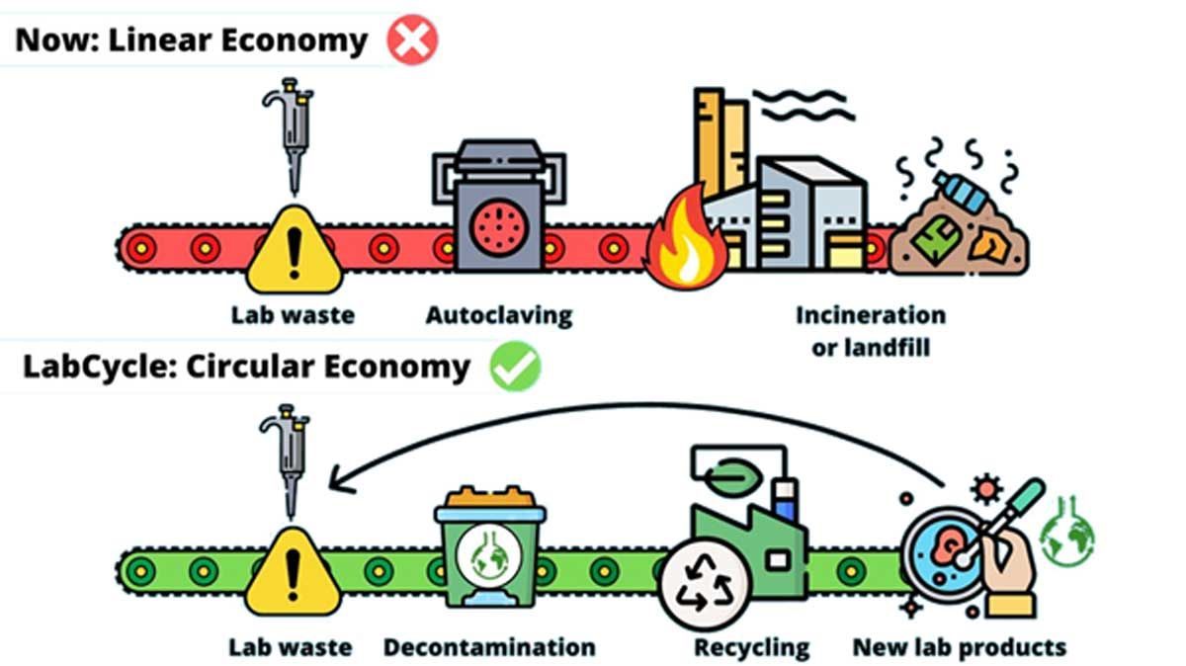
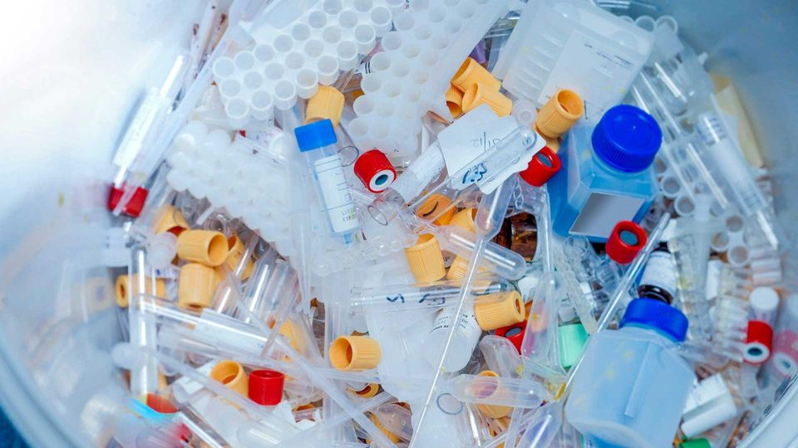
General Waste ( Single-use Plastics)
How to minimize waste?
-Implementation of Recycling Programs
-Reducing single-use plastics through the adoption of reusable alternatives, such as glassware
-Encouraging proper segregation of waste streams ensures that recyclable materials are not contaminated
-Green chemistry principles
Notes:
Labs produce a significant amount of non-hazardous waste, primarily plastics. The sheer volume of plastic disposables used in research, from pipette tips to petri dishes, contributes heavily to landfill waste. This plastic waste not only represents a loss of resources but also poses long-term environmental challenges. Laboratories often generate a high volume of plastic waste from single-use items like pipette tips, tubes, and culture flasks, contributing to the growing problem of plastic pollution.
Reduction Strategies: Propose ways to minimize waste, including recycling programs, green chemistry, and reducing single-use plastics.
To minimize waste, labs can adopt several strategies. Recycling programs should be implemented to divert as much waste as possible from landfills. Green chemistry principles can reduce the use and generation of hazardous substances. Reducing single-use plastics through the adoption of reusable alternatives, such as glassware, can significantly lower the waste footprint. Encouraging proper segregation of waste streams ensures that recyclable materials are not contaminated and can be effectively processed.

Slide 8
Resource Use
-Water consumption: Laboratories can be significant consumers of water, particularly in processes that require constant cooling or cleaning.
-Material sourcing: Consider the environmental cost of sourcing materials. The production and transportation of lab reagents, equipment, and animals for testing can have considerable ecological footprints.
Notes:
Resource Use (3 minutes)
• Water Consumption: Examine the use of water in research and its conservation.
Laboratories can be significant consumers of water, particularly in processes that require constant cooling or cleaning. Managing water use efficiently is crucial, as excessive consumption can strain local water supplies and increase the environmental footprint of research activities. Simple measures, such as fixing leaks, using water-efficient autoclaves, and implementing water recirculation systems, can lead to substantial water savings.
• Material Sourcing: Consider the environmental cost of sourcing materials (e.g., rare reagents, animals for testing).
The environmental impact of research is not limited to the lab; it also includes the sourcing of materials. The production and transportation of lab reagents, equipment, and animals for testing can have considerable ecological footprints. Sustainable procurement policies, which prioritize suppliers that follow environmentally friendly practices, can help mitigate these impacts. Additionally, sourcing locally can reduce the carbon footprint associated with transportation.
• Reduction Strategies: Labs can further reduce resource use by carefully planning experiments to avoid unnecessary repetition and by sharing materials and equipment with other research groups. Implementing a digital inventory management system can help track and optimize the use of resources, reducing waste and ensuring that materials are used efficiently.

Slide 9
Carbon Footprint
Notes:
Optimizing scientific travel, for example, by grouping engagements, choosing eco-friendly travel options, and virtual attendance, can help reduce our carbon footprint. However, we remain mindful of the differential effects of altering travel patterns, as reducing travel will impact academics differently based on location and country income levels. A sad irony is that while most high-quality scientific research takes place in high-income countries, the bulk of its negative environmental impact is felt in lower- and middle-income countries. Moreover, these communities will likely be the last to benefit from the mitigating effects of scientific research, including novel energy technologies and next-generation vaccines that could protect against new infections arising from habitat destruction. The COVID-19 pandemic provided an example of the challenges to providing an equitable response to global emergencies.
Links:
https://www.biointeractive.org/classroom-resources/what-my-carbon-footprint

Slide 10
Carbon Footprint
Travel
Digital Footprint
Academic travel for conferences, fieldwork, and collaborations
Alternatives:
-reduced number of conferences
-reduced air travel (online meetings)
-combined meetings and travel
The carbon cost of data storage and processing is often overlooked but increasingly relevant, especially with the rise of computational research and AI. Data centers consume vast amounts of energy, contributing to greenhouse gas emissions.
Alternatives:
-Efficient data management
-cloud storage solutions with renewable energy sources
-minimizing unnecessary data processing
Notes:
Carbon Footprint (3 minutes)
• Travel: Discuss the impact of academic travel (conferences, fieldwork) on carbon emissions.
Academic travel for conferences, fieldwork, and collaborations contributes significantly to the carbon footprint of research. Air travel, in particular, generates large amounts of CO2 emissions. While travel is often essential for research and professional development, it is important to seek alternatives that can reduce environmental impact.
• Digital Footprint: Highlight the carbon cost of data storage and processing, especially relevant in computational research and new AIs.
The carbon cost of data storage and processing is often overlooked but increasingly relevant, especially with the rise of computational research and AI. Data centers consume vast amounts of energy, contributing to greenhouse gas emissions. Efficient data management, cloud storage solutions with renewable energy sources, and minimizing unnecessary data processing can help reduce the digital carbon footprint.

Slide 11
Sustainable Research Practices
Programs like LEED (Leadership in Energy and Environmental Design) and My Green Lab Certification provide frameworks for implementing sustainable practices in laboratories. These certifications encourage energy efficiency, waste reduction, and sustainable procurement, helping labs minimize their environmental impact. By achieving certification, labs demonstrate their commitment to sustainability and can serve as models for others.
Institutions like the University of California, San Francisco (UCSF), and Harvard University have successfully implemented sustainable practices in their labs. UCSF’s Green Labs Program, for example, has focused on energy-efficient equipment, waste reduction, and sustainable purchasing, leading to significant environmental benefits. Harvard’s Green Labs Initiative has similarly promoted energy conservation, waste reduction, and green chemistry, showcasing the positive impact of sustainable research practices.
Notes:
LEED Certification
LEED (Leadership in Energy and Environmental Design) is a globally recognized green building certification system developed by the U.S. Green Building Council (USGBC). LEED provides a framework for healthy, efficient, and cost-saving green buildings and is available for virtually all building types, including labs. Key aspects of LEED certification include:
1. Sustainable Sites: Encourages strategies that minimize the impact on ecosystems and water resources.
2. Water Efficiency: Promotes smarter use of water, inside and out, to reduce potable water consumption.
3. Energy and Atmosphere: Focuses on energy performance, including energy-efficient design, construction, and operations.
4. Materials and Resources: Promotes sustainable building materials and reduction of waste.
5. Indoor Environmental Quality: Emphasizes improving indoor air quality and access to natural light.
6. Innovation: Recognizes innovative building features and sustainable practices.
7. Regional Priority: Addresses regional environmental priorities for buildings in different geographical areas.
Buildings are awarded points based on the extent to which they meet these criteria, and the total points determine the level of certification: Certified, Silver, Gold, or Platinum.
My Green Lab Certification
My Green Lab Certification is a sustainability certification specifically designed for laboratories. It focuses on integrating sustainable practices into lab operations and is recognized as a standard for laboratory sustainability worldwide. Key components of the My Green Lab certification include:
1. Energy Efficiency: Promotes the use of energy-efficient equipment and practices, such as shutting down idle equipment and optimizing HVAC systems.
2. Water Conservation: Encourages reducing water consumption through efficient lab practices and technologies.
3. Waste Reduction: Focuses on minimizing waste generation and improving recycling and waste management programs.
4. Green Chemistry: Encourages the use of safer chemicals and sustainable laboratory practices.
5. Sustainable Procurement: Promotes the purchase of sustainable lab products and materials.
6. Employee Engagement: Emphasizes educating and engaging lab staff in sustainable practices.
7. Continuous Improvement: Encourages ongoing assessment and improvement of sustainability practices in the lab.
Labs can achieve different levels of certification (Bronze, Silver, Gold, and Platinum) based on the extent of their sustainability practices.
Examples of Institutions Implementing Sustainable Practices:
1. UCSF - Sustainable Labs Program: UCSF has a comprehensive Sustainable Labs Program that includes energy efficiency, waste reduction, and sustainable purchasing. UCSF labs have implemented ultra-low temperature (ULT) freezer management practices to save energy, reduced single-use plastics, and participated in the My Green Lab Certification program (gold rating)
2. Harvard University: Green Labs Initiative: Harvard’s Green Labs Program promotes energy and water conservation, waste reduction, and green chemistry. The university encourages labs to purchase energy-efficient equipment and follow best practices for sustainable lab operations. Harvard have achieved significant energy savings and reduced their environmental impact through various initiatives, including the use of energy-efficient fume hoods and participation in recycling programs.
3. University of Colorado Boulder: Green Labs Program: The University of Colorado Boulder’s Green Labs Program focuses on reducing energy and resource use in laboratories. The program provides resources and support for labs to implement sustainable practices, such as efficient use of lab equipment and reduction of plastic waste. CU Boulder’s Green Labs Program has led to substantial energy savings and waste reduction, earning recognition for its efforts in promoting lab sustainability.
4. University of Illinois: Illinois Sustainable Technology Center (ISTC): The ISTC at the University of Illinois focuses on sustainable technology and practices in research and industry. The center promotes energy efficiency, waste reduction, and sustainable materials management in its labs. The ISTC has implemented numerous projects that have reduced energy consumption and waste generation in their laboratories, showcasing innovative approaches to sustainability.
5. MIT: Green Labs Program: MIT’s Green Labs Program supports sustainable lab practices through initiatives such as energy-efficient lab equipment, recycling programs, and sustainable procurement. The program encourages labs to participate in the My Green Lab Certification. MIT has achieved significant reductions in energy use and waste generation in its laboratories, contributing to the university’s broader sustainability goals.
6. Stanford University: Stanford University has a comprehensive sustainability program that includes a focus on sustainable laboratory practices. The university’s Green Labs Program promotes energy conservation, waste reduction, and sustainable purchasing in labs. Stanford’s Green Labs Program has led to notable improvements in lab sustainability, including energy savings and reductions in laboratory waste.
7. University of Oxford: Sustainable Laboratories: The University of Oxford has implemented a sustainable labs initiative that promotes best practices for energy efficiency, waste management, and sustainable purchasing. The university encourages labs to adopt sustainable practices and provides resources and support to achieve this.
Links:
https://act.mygreenlab.org/
https://www.rockefeller.edu/news/23682-new-campus-caterer-to-focus-on-fresh-food-variety-and-sustainability/
https://www.rockefeller.edu/news/31894-stavros-niarchos-foundation-david-rockefeller-river-campus-receives-leed-gold-certification/#
https://www.rockefeller.edu/news/35763-rockefeller-joins-city-partnership-to-reduce-carbon-footprint/

Slide 12
Policy and Funding
Institutional Policies
Funding Agencies
Establishing guidelines for energy use, waste management, and sustainable procurement can create a culture of sustainability.
Inclusion of sustainability criteria in grant applications and providing funding for green initiatives.
Notes:
Policy and Funding (3 minutes)
• Institutional Policies: Discuss how universities and research institutions can implement policies to support sustainable research.
Universities and research institutions play a crucial role in promoting sustainable research through policy implementation. Establishing guidelines for energy use, waste management, and sustainable procurement can create a culture of sustainability. Institutions can also incentivize green practices by recognizing and rewarding labs that demonstrate significant efforts in reducing their environmental impact.
• Funding Agencies: Highlight the role of funding agencies in promoting environmental sustainability in research.
Funding agencies can support environmental sustainability in research by prioritizing grants for projects that incorporate sustainable practices. By including sustainability criteria in grant applications and providing funding for green initiatives, these agencies can drive the adoption of environmentally friendly practices in the research community. Programs that support infrastructure upgrades and the adoption of new technologies can further enhance sustainability efforts.
Links:
https://www.hhs.gov/sites/default/files/hhs-climate-action-plan-9-28-2021.pdf
https://act.mygreenlab.org/
https://betrgrants.weebly.com/

